Slide 1
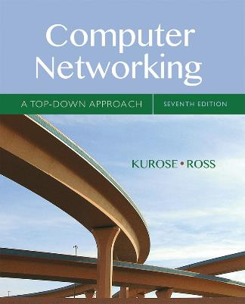
Chapter 5 Network Layer:
The Control Plane
A note on the use of these Powerpoint slides:
We’re making these slides freely available to all (faculty, students, readers). They’re in PowerPoint form so you see the animations; and can add, modify, and delete slides (including this one) and slide content to suit your needs. They obviously represent a lot of work on our part. In return for use, we only ask the following:
Computer Networking: A Top Down Approach
If you use these slides (e.g., in a class) that you mention their source (after all, we’d like people to use our book!)
If you post any slides on a www site, that you note that they are adapted from (or perhaps identical to) our slides, and note our copyright of this material.
Thanks and enjoy! JFK/KWR
All material copyright 1996-2016
J.F Kurose and K.W. Ross, All Rights Reserved
7th edition Jim Kurose, Keith Ross Pearson/Addison Wesley April 2016

Slide 2
Chapter 5: network layer control plane
chapter goals: understand principles behind network control plane
traditional routing algorithms
SDN controlllers
Internet Control Message Protocol
network management
and their instantiation, implementation in the Internet:
OSPF, BGP, OpenFlow, ODL and ONOS controllers, ICMP, SNMP

Slide 3
Chapter 5: outline
5.1 introduction
5.2 routing protocols
link state
distance vector
5.3 intra-AS routing in the Internet: OSPF
5.4 routing among the ISPs: BGP
5.5 The SDN control plane
5.6 ICMP: The Internet Control Message Protocol
5.7 Network management and SNMP

Slide 4
Network-layer functions
Recall: two network-layer functions:
forwarding: move packets from router’s input to appropriate router output
data plane
routing: determine route taken by packets from source to destination
control plane
Two approaches to structuring network control plane:
per-router control (traditional)
logically centralized control (software defined networking)

Slide 5
Per-router control plane
Individual routing algorithm components in each and every router interact with each other in control plane to compute forwarding tables
Routing
Algorithm
control
plane
data
plane

Slide 6
Logically centralized control plane
A distinct (typically remote) controller interacts with local control agents (CAs) in routers to compute forwarding tables
Remote Controller
control
plane
data
plane
CA
CA
CA
CA
CA

Slide 7
Chapter 5: outline
5.1 introduction
5.2 routing protocols
link state
distance vector
5.3 intra-AS routing in the Internet: OSPF
5.4 routing among the ISPs: BGP
5.5 The SDN control plane
5.6 ICMP: The Internet Control Message Protocol
5.7 Network management and SNMP

Slide 8
Routing protocols
Routing protocol goal: determine “good” paths (equivalently, routes), from sending hosts to receiving host, through network of routers
path: sequence of routers packets will traverse in going from given initial source host to given final destination host
“good”: least “cost”, “fastest”, “least congested”
routing: a “top-10” networking challenge!

Slide 9
Graph abstraction of the network
5
v
3
w
2
5
u
2
1
z
3
1
2
x
y
1
graph: G = (N,E)
N = set of routers = { u, v, w, x, y, z }
E = set of links ={ (u,v), (u,x), (v,x), (v,w), (x,w), (x,y), (w,y), (w,z), (y,z) }
aside: graph abstraction is useful in other network contexts, e.g.,
P2P, where N is set of peers and E is set of TCP connections

Slide 10
Graph abstraction: costs
5
c(x,x’) = cost of link (x,x’)
e.g., c(w,z) = 5
cost could always be 1, or
inversely related to bandwidth,
or inversely related to
congestion
v
3
w
2
5
u
2
1
z
3
1
2
x
y
1
cost of path (x₁, x₂, x₃,…, x_{p}) = c(x₁,x₂) + c(x₂,x₃) + … + c(x_{p-1},x_{p})
key question: what is the least-cost path between u and z ?
routing algorithm: algorithm that finds that least cost path

Slide 11
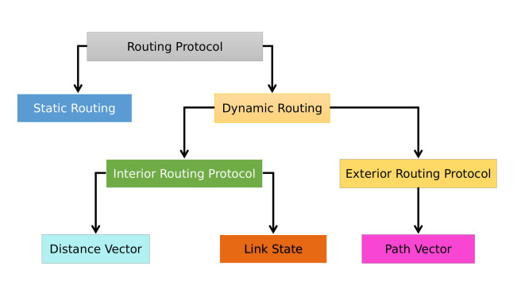
https://ciscostudy.org/2018/12/02/routing-protocols-dynamic-routing/

Slide 12
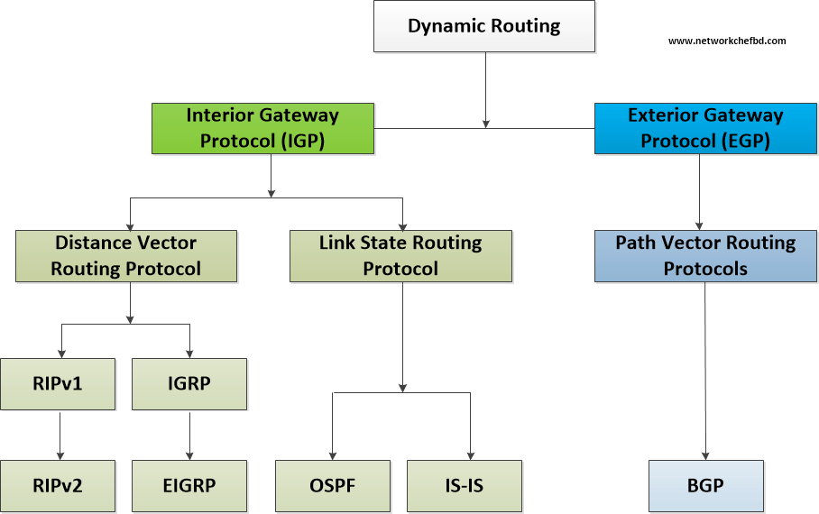

Slide 13
Routing algorithm classification
Q: global or decentralized information?
global:
all routers have complete topology, link cost info
“link state” algorithms
decentralized:
router knows physically-connected neighbors, link costs to neighbors
iterative process of computation, exchange of info with neighbors
“distance vector” algorithms
Q: static or dynamic?
static:
routes change slowly over time
dynamic:
routes change more quickly
periodic update
in response to link cost changes

Slide 14
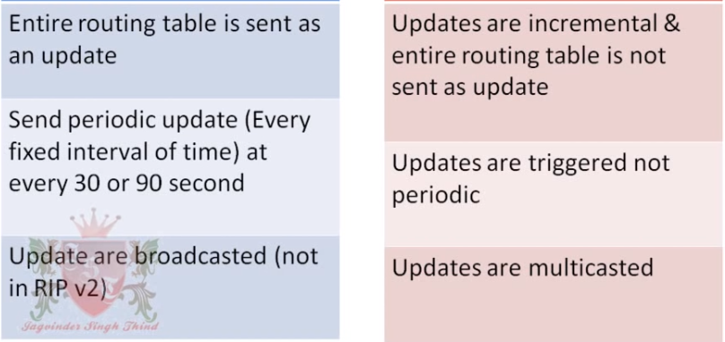
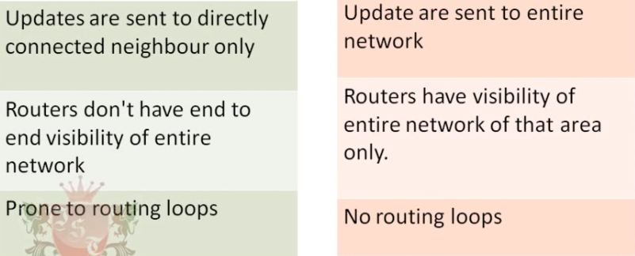
DISTANCE VECTOR VS LINK STATE

Slide 15
Chapter 5: outline
5.1 introduction
5.2 routing protocols
link state
distance vector
5.3 intra-AS routing in the Internet: OSPF
5.4 routing among the ISPs: BGP
5.5 The SDN control plane
5.6 ICMP: The Internet Control Message Protocol
5.7 Network management and SNMP

Slide 16
A link-state routing algorithm
Dijkstra’s algorithm
net topology, link costs known to all nodes
accomplished via “link state broadcast”
all nodes have same info
computes least cost paths from one node (‘source”) to all other nodes
gives forwarding table for that node
iterative: after k iterations, know least cost path to k dest.’s
notation:
c(x,y): link cost from node x to y; = ∞ if not direct neighbors
D(v): current value of cost of path from source to dest. v
p(v): predecessor node along path from source to v
N': set of nodes whose least cost path definitively known

Slide 17
Dijsktra’s algorithm
1 Initialization:
2 N' = {u}
3 for all nodes v
4 if v adjacent to u
5 then D(v) = c(u,v)
6 else D(v) = ∞
7
8 Loop
9 find w not in N' such that D(w) is a minimum
10 add w to N'
11 update D(v) for all v adjacent to w and not in N' :
12 D(v) = min( D(v), D(w) + c(w,v) )
13 /* new cost to v is either old cost to v or known
14 shortest path cost to w plus cost from w to v */
15 until all nodes in N'

Slide 18
Dijkstra’s algorithm: example
D(v)
p(v)
D(w)
p(w)
D(x)
p(x)
D(y)
p(y)
D(z)
p(z)
Step
N'
0
u
7,u
3,u
5,u
∞
∞
1
uw
6,w
5,u
11,w
∞
2
uwx
6,w
11,w
14,x
3
uwxv
10,v
14,x
4
uwxvy
12,y
5
uwxvyz
x
9
notes:
construct shortest path tree by tracing predecessor nodes
ties can exist (can be broken arbitrarily)
5
7
4
8
u
3
w
y
z
2
3
7
4
v

Slide 19
Dijkstra’s algorithm: another example
Step
0
1
2
3
4
5
N'
u
ux
uxy
uxyv
uxyvw
uxyvwz
D(v),p(v)
2,u
2,u
2,u
D(w),p(w)
5,u
4,x
3,y
3,y
D(x),p(x)
1,u
D(y),p(y)
∞
2,x
D(z),p(z)
∞
∞
4,y
4,y
4,y
5
v
3
w
2
5
u
2
1
z
3
1
2
x
y
1
* Check out the online interactive exercises for more examples: http://gaia.cs.umass.edu/kurose_ross/interactive/

Slide 20
Dijkstra’s algorithm: example (2)
resulting shortest-path tree from u:
v
w
u
z
x
y
resulting forwarding table in u:
destination
link
v
(u,v)
x
(u,x)
y
(u,x)
w
(u,x)
z
(u,x)

Slide 21
Dijkstra’s algorithm, discussion
algorithm complexity: n nodes
each iteration: need to check all nodes, w, not in N
n(n+1)/2 comparisons: O(n²)
more efficient implementations possible: O(nlogn)
oscillations possible:
e.g., support link cost equals amount of carried traffic:
A
A
A
A
1
1+e
2+e
0
0
2+e
2+e
0
D
B
D
B
D
B
D
B
0
0
1+e
1
0
0
1+e
1
0
C
e
0
0
1
0
0
1
C
C
1+e
C
1
e
initially
given these costs,
find new routing….
resulting in new costs
given these costs,
find new routing….
resulting in new costs
given these costs,
find new routing….
resulting in new costs

Slide 22
Chapter 5: outline
5.1 introduction
5.2 routing protocols
link state
distance vector
5.3 intra-AS routing in the Internet: OSPF
5.4 routing among the ISPs: BGP
5.5 The SDN control plane
5.6 ICMP: The Internet Control Message Protocol
5.7 Network management and SNMP

Slide 23
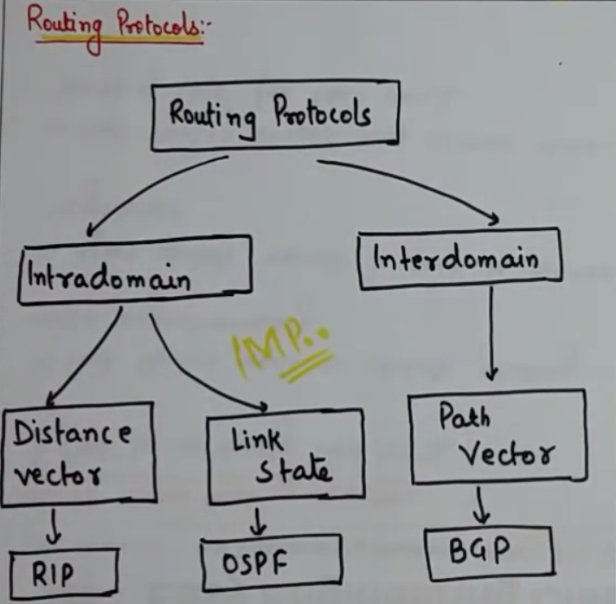

Slide 24
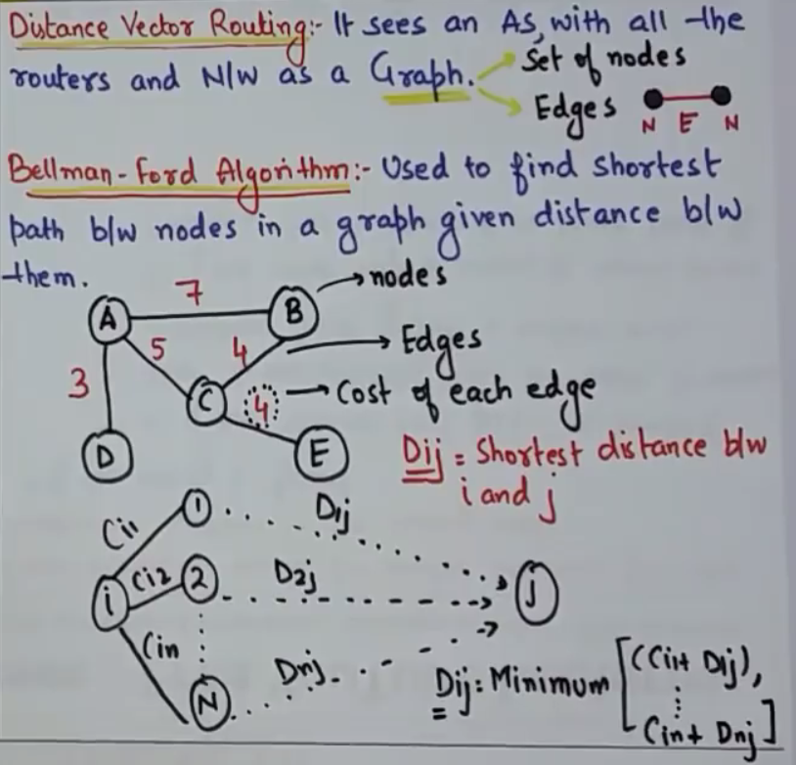

Slide 25
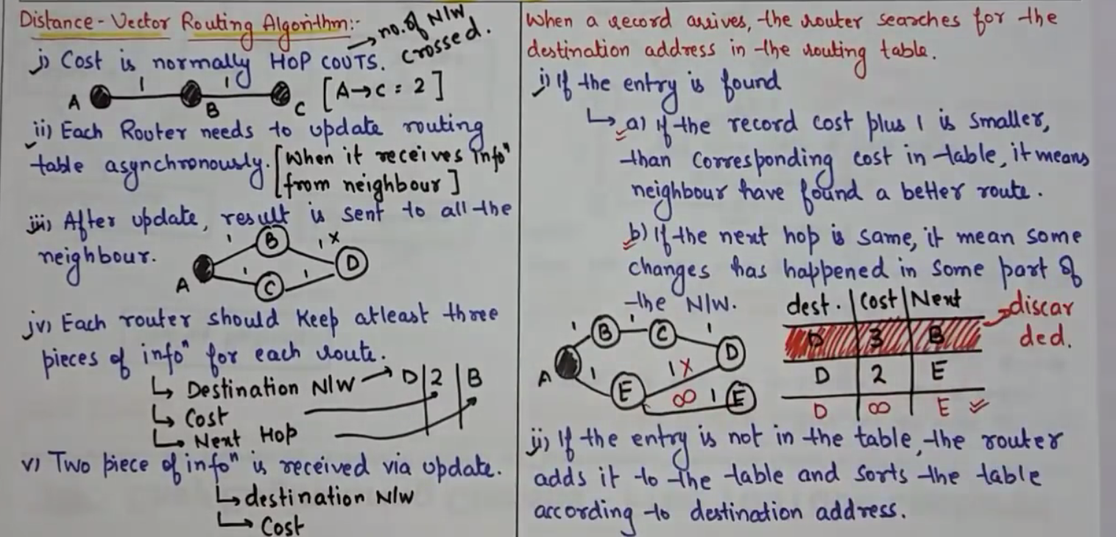

Slide 26
Distance vector algorithm
Bellman-Ford equation (dynamic programming)
let
d_{x}(y) := cost of least-cost path from x to y
then
d_{x}(y) = min {c(x,v) + d_{v}(y) }
v
cost from neighbor v to destination y
cost to neighbor v
min taken over all neighbors v of x

Slide 27
Bellman-Ford example
5
clearly, d_{v}(z) = 5, d_{x}(z) = 3, d_{w}(z) = 3
v
3
w
2
5
u
z
B-F equation says:
2
1
3
1
2
d_{u}(z) = min { c(u,v) + d_{v}(z),
c(u,x) + d_{x}(z),
c(u,w) + d_{w}(z) }
= min {2 + 5,
1 + 3,
5 + 3} = 4
x
y
1
node achieving minimum is next
hop in shortest path, used in forwarding table

Slide 28
Distance vector algorithm
D_{x}(y) = estimate of least cost from x to y
x maintains distance vector D_{x} = [D_{x}(y): y є N ]
node x:
knows cost to each neighbor v: c(x,v)
maintains its neighbors’ distance vectors. For each neighbor v, x maintains D_{v} = [D_{v}(y): y є N ]

Slide 29
Distance vector algorithm
key idea:
from time-to-time, each node sends its own distance vector estimate to neighbors
when x receives new DV estimate from neighbor, it updates its own DV using B-F equation:
D_{x}(y) ← min_{v}{c(x,v) + D_{v}(y)} for each node y ∊ N
under minor, natural conditions, the estimate D_{x}(y) converge to the actual least cost d_{x}(y)

Slide 30
Distance vector algorithm
iterative, asynchronous: each local iteration caused by:
local link cost change
DV update message from neighbor
distributed:
each node notifies neighbors only when its DV changes
neighbors then notify their neighbors if necessary
each node:
wait for (change in local link cost or msg from neighbor)
recompute estimates
if DV to any dest has changed, notify neighbors

Slide 31
D_{x}(z) = min{c(x,y) + D_{y}(z), c(x,z) + D_{z}(z)}
= min{2+1 , 7+0} = 3
D_{x}(y) = min{c(x,y) + D_{y}(y), c(x,z) + D_{z}(y)} = min{2+0 , 7+1} = 2
node x
table
cost to
cost to
x y z
x y z
x
0 2 7
x
0
2
3
y
y
2 0 1
from
∞
∞
∞
from
z
∞
∞
∞
z
7 1 0
node y
table
cost to
x y z
y
2
1
x
∞
∞
z
∞
2 0 1
x
from
y
7
z
∞
∞
∞
node z
table
cost to
x y z
x
∞ ∞ ∞
from
y
∞
∞
∞
z
7
1
0
time

Slide 32
D_{x}(z) = min{c(x,y) + D_{y}(z), c(x,z) + D_{z}(z)}
= min{2+1 , 7+0} = 3
D_{x}(y) = min{c(x,y) + D_{y}(y), c(x,z) + D_{z}(y)} = min{2+0 , 7+1} = 2
node x
table
cost to
cost to
cost to
x y z
x y z
x y z
x
0 2 7
x
0
2
3
x
0 2 3
y
y
2 0 1
from
∞
∞
∞
from
y
2 0 1
z
z
from
∞
∞
∞
7 1 0
z
3 1 0
node y
table
cost to
cost to
cost to
x y z
x y z
x y z
y
2
1
x
∞
∞
x
0 2 7
∞
2 0 1
x
0 2 3
x
z
from
y
y
2 0 1
y
7
from
from
2 0 1
z
∞
∞
∞
z
7 1 0
z
3 1 0
node z
table
cost to
cost to
cost to
x y z
x y z
x y z
x
∞ ∞ ∞
x
0 2 7
x
0 2 3
y
y
2 0 1
from
y
∞
∞
from
2 0 1
from
∞
z
z
3 1 0
z
3 1 0
7
1
0
time
time

Slide 33
Distance vector: link cost changes
link cost changes:
node detects local link cost change
updates routing info, recalculates distance vector
if DV changes, notify neighbors
1
y
4
1
x
z
50
“good
news
travels
fast”
t₀ : y detects link-cost change, updates its DV, informs its neighbors.
t₁ : z receives update from y, updates its table, computes new least cost to x , sends its neighbors its DV.
t₂ : y receives z’s update, updates its distance table. y’s least costs do not change, so y does not send a message to z.
* Check out the online interactive exercises for more examples: http://gaia.cs.umass.edu/kurose_ross/interactive/

Slide 34
Distance vector: link cost changes
link cost changes:
node detects local link cost change
bad news travels slow - “count to infinity” problem!
44 iterations before algorithm stabilizes: see text
60
y
4
1
x
z
50
poisoned reverse:
If Z routes through Y to get to X :
Z tells Y its (Z’s) distance to X is infinite (so Y won’t route to X via Z)
will this completely solve count to infinity problem?

Slide 35
Route Poisoning and Count to infinity problem in Routing
The main issue with Distance Vector Routing (DVR) protocols is Routing Loops, since Bellman-Ford Algorithm cannot prevent loops.
This routing loop in DVR network causes Count to Infinity Problem. Routing loops usually occur when any interface goes down or cost get increases or two-routers send updates at the same time.
Poisoned Reverse: FOR == avoidING routing loops. Poisoned Reverse: if z routes through y to get to destination x, then z will advertise to y that its di stance to x is infinity
In computer networking, split-horizon route advertisement is a method of preventing routing loops in distance-vector routing protocols by prohibiting a router from advertising a route back onto the interface from which it was learned.

Slide 36
Comparison of LS and DV algorithms
message complexity
LS: with n nodes, E links, O(nE) msgs sent
DV: exchange between neighbors only
convergence time varies
speed of convergence
LS: O(n²) algorithm requires O(nE) msgs
may have oscillations
DV: convergence time varies
may be routing loops
count-to-infinity problem
robustness: what happens if router malfunctions?
LS:
node can advertise incorrect link cost
each node computes only its own table
DV:
DV node can advertise incorrect path cost
each node’s table used by others
error propagate thru network
Notes:
Here is a list of classes of functions that are commonly encountered when analyzing algorithms. The slower growing functions are listed first. c is some arbitrary constant. notation name O(1) constant O(log(n)) logarithmic O((log(n)) c ) polylogarithmic O(n) linear O(n 2 ) quadratic O(n c ) polynomial O(c n ) exponential

Slide 37
A Comparison of LS and DV Routing Algorithms
The DV and LS algorithms take complementary approaches toward computing routing.
In the DV algorithm, each node talks to only its directly connected neighbors, but it provides its neighbors with least-cost estimates from itself to all the nodes (that it knows about) in the network.
The LS algorithm requires global information = Consequently, when implemented in each and every router each node would need to communicate with all other nodes (via broadcast), but it tells them only the costs of its directly connected links.
Let’s conclude our study of LS and DV algorithms with a quick comparison of some of their attributes.
Recall that N is the set of nodes (routers) and E is the set of edges (links).

Slide 38
Message complexity.
We have seen that LS requires each node to know the cost of each link in the network.
This requires O(|N| |E|) messages to be sent. Also, whenever a link cost changes, the new link cost must be sent to all nodes.
The DV algorithm requires message exchanges between directly connected neighbors at each iteration.
We have seen that the time needed for the algorithm to converge can depend on many factors.
When link costs change, the DV algorithm will propagate the results of the changed link cost only if the new link cost results in a changed least-cost path for one of the nodes attached to that link.

Slide 39
Speed of convergence.
We have seen that our implementation of LS: O(n²) algorithm requires O(nE) msgs
The DV algorithm can converge slowly and can have routing loops while the algorithm is converging. DV also suffers from the count-to-infinity problem.
Robustness.
What can happen if a router fails, misbehaves, or is sabotaged?
Under LS, a router could broadcast an incorrect cost for one of its attached links (but no others).
A node could also corrupt or drop any packets it received as part of an LS broadcast.
But an LS node is computing only its own forwarding tables; other nodes are performing similar calculations for themselves.
This means route calculations are somewhat separated under LS, providing a degree of robustness

Slide 40
Robustness (CONTINUE):
Under DV, a node can advertise incorrect least-cost paths to any or all destinations.
(Indeed, in 1997, a malfunctioning router in a small ISP provided national backbone routers with erroneous routing information. This caused other routers to flood the malfunctioning router with traffic and caused large portions of the Internet to become disconnected for up to several hours [Neumann 1997].)
More generally, we note that, at each iteration, a node’s calculation in DV is passed on to its neighbor and then indirectly to its neighbor’s neighbor on the next iteration.
In this sense, an incorrect node calculation can be diffused through the entire network under DV.
In the end, neither algorithm is an obvious winner over the other; indeed, both algorithms are used in the Internet.

Slide 41
Chapter 5: outline
5.1 introduction
5.2 routing protocols
link state
distance vector
5.3 intra-AS routing in the Internet: OSPF
5.4 routing among the ISPs: BGP
5.5 The SDN control plane
5.6 ICMP: The Internet Control Message Protocol
5.7 Network management and SNMP

Slide 42
Making routing scalable
our routing study thus far - idealized
all routers identical
network “flat”
… not true in practice
scale: with billions of destinations:
can’t store all destinations in routing tables!
routing table exchange would swamp links!
administrative autonomy
internet = network of networks
each network admin may want to control routing in its own network

Slide 43
Both of these problems can be solved by organizing routers into autonomous systems (ASs),
With each AS consisting of a group of routers that are under the same administrative control.
Often the routers in an ISP, and the links that interconnect them, constitute a single AS.
Some ISPs, however, partition their network into multiple ASs.
In particular, some tier-1 ISPs use one gigantic AS for their entire network, whereas others break up their ISP into tens of interconnected ASs.
An autonomous system is identified by its globally unique autonomous system number (ASN) [RFC 1930]. AS numbers, like IP addresses, are assigned by ICANN regional registries [ICANN 2016].

Slide 44
Routers within the same AS all run the same routing algorithm and have information about each other.
The routing algorithm running within an autonomous system is called an intra-autonomous system routing protocol

Slide 45
Internet approach to scalable routing
aggregate routers into regions known as “autonomous systems” (AS) (a.k.a. “domains”)
intra-AS routing
routing among hosts, routers in same AS (“network”)
all routers in AS must run same intra-domain protocol
routers in different AS can run different intra-domain routing protocol
gateway router: at “edge” of its own AS, has link(s) to router(s) in other AS’es
inter-AS routing
routing among AS’es
gateways perform inter-domain routing (as well as intra-domain routing)

Slide 46
Interconnected ASes
3c
3a
2c
3b
AS3
2a
1c
2b
AS2
1a
1b
1d
AS1
forwarding table configured by both intra- and inter-AS routing algorithm
intra-AS routing determine entries for destinations within AS
inter-AS & intra-AS determine entries for external destinations
Intra-AS
Routing
algorithm
Inter-AS
Routing
algorithm
Forwarding
table

Slide 47
Inter-AS tasks
suppose router in AS1 receives datagram destined outside of AS1:
router should forward packet to gateway router, but which one?
AS1 must:
learn which dests are reachable through AS2, which through AS3
propagate this reachability info to all routers in AS1
job of inter-AS routing!
3c
3a
3b
AS3
2c
other
networks
1c
2a
other
networks
1a
2b
1b
AS2
AS1
1d

Slide 48
Intra-AS Routing
also known as interior gateway protocols (IGP)
most common intra-AS routing protocols:
RIP: Routing Information Protocol
OSPF: Open Shortest Path First (IS-IS protocol essentially same as OSPF)
IGRP: Interior Gateway Routing Protocol (Cisco proprietary for decades, until 2016)

Slide 49
OSPF (Open Shortest Path First)
“open”: publicly available
uses link-state algorithm
link state packet dissemination
topology map at each node
route computation using Dijkstra’s algorithm
router floods OSPF link-state advertisements to all other routers in entire AS
carried in OSPF messages directly over IP (rather than TCP or UDP
link state: for each attached link
IS-IS routing protocol: nearly identical to OSPF

Slide 50
OSPF “advanced” features
security: all OSPF messages authenticated (to prevent malicious intrusion)
multiple same-cost paths allowed (only one path in RIP)
for each link, multiple cost metrics for different TOS (e.g., satellite link cost set low for best effort ToS; high for real-time ToS)
integrated uni- and multi-cast support:
Multicast OSPF (MOSPF) uses same topology data base as OSPF
hierarchical OSPF in large domains.

Slide 51
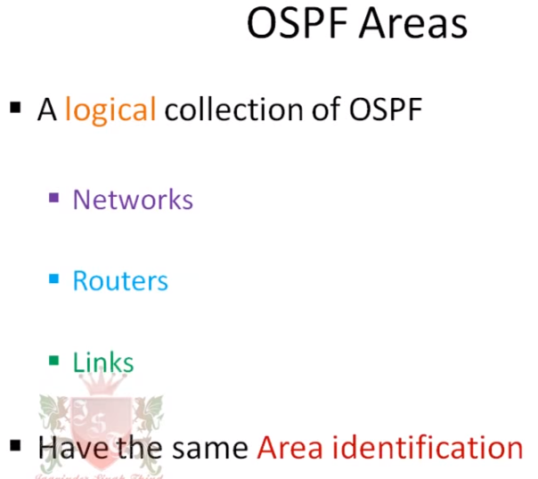

Slide 52
Support for hierarchy within a single AS.
An OSPF autonomous system can be configured hierarchically into areas.
Each area runs its own OSPF link-state routing algorithm, with each router in an area broadcasting its link state to all other routers in that area.
Within each area, one or more area border routers are responsible for routing packets outside the area.
Lastly, exactly one OSPF area in the AS is configured to be the backbone area.
The primary role of the backbone area is to route traffic between the other areas in the AS.
The backbone always contains all area border routers in the AS and may contain non-border routers as well.
Inter-area routing within the AS requires that the packet be first routed to an area border router (intra-area routing), then routed through the backbone to the area border router that is in the destination area, and then routed to the final destination.

Slide 53
Hierarchical OSPF
boundary router
backbone router
backbone
area
border
routers
area 3
internal
routers
area 1
area 2

Slide 54
Hierarchical OSPF
two-level hierarchy: local area, backbone.
link-state advertisements only in area
each nodes has detailed area topology; only know direction (shortest path) to nets in other areas.
area border routers: “summarize” distances to nets in own area, advertise to other Area Border routers.
backbone routers: run OSPF routing limited to backbone.
boundary routers: connect to other AS’es.

Slide 55
Chapter 5: outline
5.1 introduction
5.2 routing protocols
link state
distance vector
5.3 intra-AS routing in the Internet: OSPF
5.4 routing among the ISPs: BGP
5.5 The SDN control plane
5.6 ICMP: The Internet Control Message Protocol
5.7 Network management and SNMP

Slide 56
Internet inter-AS routing: BGP
BGP (Border Gateway Protocol): the de facto inter-domain routing protocol
“glue that holds the Internet together”
BGP provides each AS a means to:
eBGP: obtain subnet reachability information from neighboring ASes
iBGP: propagate reachability information to all AS-internal routers.
determine “good” routes to other networks based on reachability information and policy
allows subnet to advertise its existence to rest of Internet: “I am here”

Slide 57
eBGP, iBGP connections
2b
∂
2a
2c
1b
3b
2d
∂
1a
1c
3a
3c
AS 2
1d
3d
AS 1
eBGP connectivity
AS 3
iBGP connectivity
1c
gateway routers run both eBGP and iBGP protocols

Slide 58
BGP basics
BGP session: two BGP routers (“peers”) exchange BGP messages over semi-permanent TCP connection:
advertising paths to different destination network prefixes (BGP is a “path vector” protocol)
when AS3 gateway router 3a advertises path AS3,X to AS2 gateway router 2c:
AS3 promises to AS2 it will forward datagrams towards X
AS 3
3b
AS 1
1b
3a
3c
1a
1c
AS 2
2b
3d
X
1d
2a
2c
BGP advertisement:
AS3, X
2d

Slide 59
Path attributes and BGP routes
advertised prefix includes BGP attributes
prefix + attributes = “route”
two important attributes:
AS-PATH: list of ASes through which prefix advertisement has passed
NEXT-HOP: indicates specific internal-AS router to next-hop AS
Policy-based routing:
gateway receiving route advertisement uses import policy to accept/decline path (e.g., never route through AS Y).
AS policy also determines whether to advertise path to other other neighboring ASes

Slide 60
BGP path advertisement
AS3
3b
AS1
1b
3a
3c
1a
1c
AS2
2b
3d
X
1d
AS3,X
AS2,AS3,X
2a
2c
2d
AS2 router 2c receives path advertisement AS3,X (via eBGP) from AS3 router 3a
Based on AS2 policy, AS2 router 2c accepts path AS3,X, propagates (via iBGP) to all AS2 routers
Based on AS2 policy, AS2 router 2a advertises (via eBGP) path AS2, AS3, X to AS1 router 1c

Slide 61
BGP path advertisement
AS3
3b
AS1
1b
AS3,X
3a
3c
1a
1c
AS2
2b
3d
X
1d
AS3,X
AS2,AS3,X
2a
2c
2d
gateway router may learn about multiple paths to destination:
AS1 gateway router 1c learns path AS2,AS3,X from 2a
AS1 gateway router 1c learns path AS3,X from 3a
Based on policy, AS1 gateway router 1c chooses path AS3,X, and advertises path within AS1 via iBGP

Slide 62
BGP messages
BGP messages exchanged between peers over TCP connection
BGP messages:
OPEN: opens TCP connection to remote BGP peer and authenticates sending BGP peer
UPDATE: advertises new path (or withdraws old)
KEEPALIVE: keeps connection alive in absence of UPDATES; also ACKs OPEN request
NOTIFICATION: reports errors in previous msg; also used to close connection

Slide 63
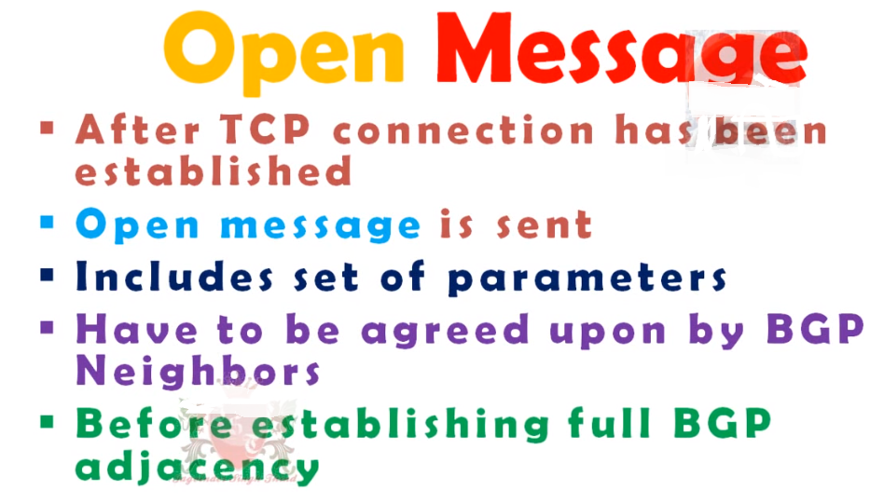

Slide 64
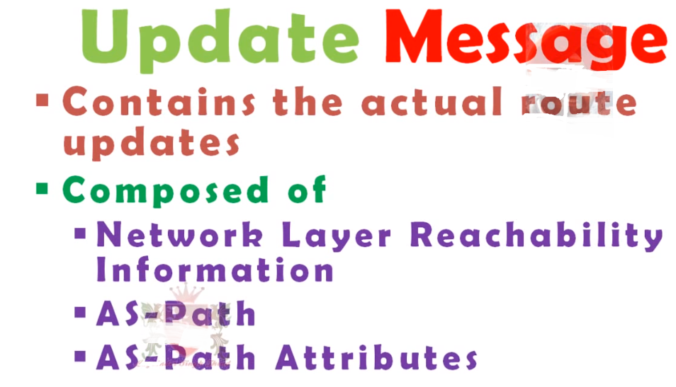

Slide 65
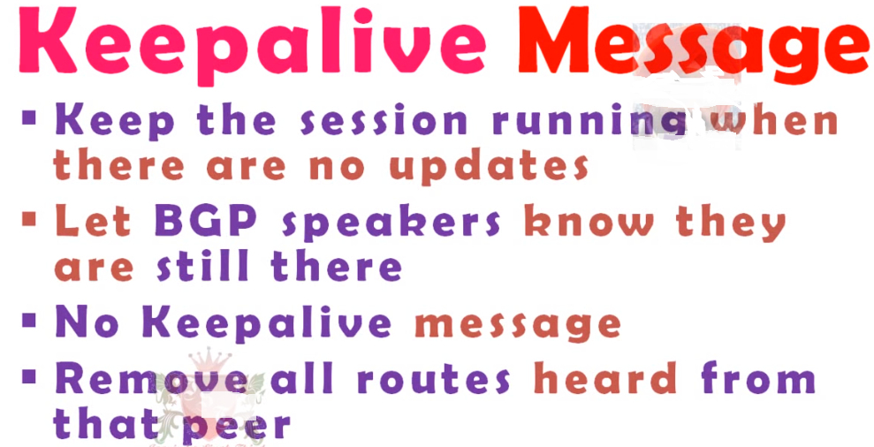

Slide 66
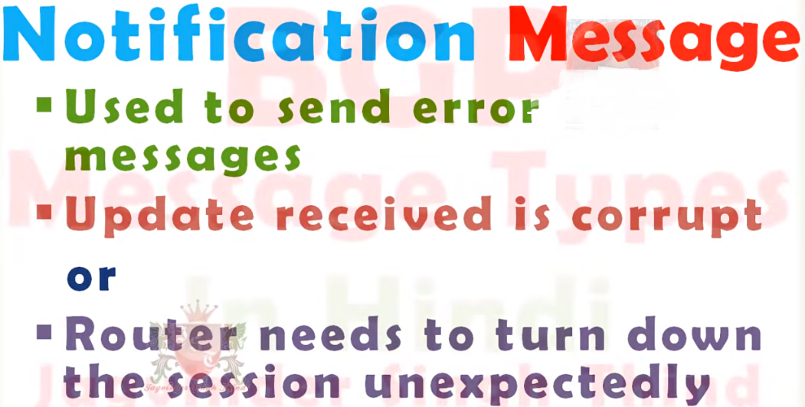

Slide 67
BGP, OSPF, forwarding table entries
Q: how does router set forwarding table entry to distant prefix?
AS3
3b
AS1
1b
AS3,X
1
AS3,X
3a
3c
1a
2
1c
local link interfaces
at 1a, 1d
AS2
2b
3d
X
2
1d
1
AS3,X
AS2,AS3,X
2a
2c
physical link
2d
dest
interface
recall: 1a, 1b, 1c learn about dest X via iBGP from 1c: “path to X goes through 1c”
…
…
…
…
X
1
1d: OSPF intra-domain routing: to get to 1c, forward over outgoing local interface 1

Slide 68
BGP, OSPF, forwarding table entries
Q: how does router set forwarding table entry to distant prefix?
AS3
3b
AS1
1b
1
3a
3c
1a
2
1c
AS2
2b
3d
X
1d
2a
2c
2d
dest
interface
recall: 1a, 1b, 1c learn about dest X via iBGP from 1c: “path to X goes through 1c”
…
…
…
…
X
2
1d: OSPF intra-domain routing: to get to 1c, forward over outgoing local interface 1
1a: OSPF intra-domain routing: to get to 1c, forward over outgoing local interface 2

Slide 69
BGP route selection
router may learn about more than one route to destination AS, selects route based on:
local preference value attribute: policy decision
shortest AS-PATH
closest NEXT-HOP router: hot potato routing
additional criteria

Slide 70
Hot Potato Routing
AS3
3b
AS1
1b
3a
3c
1a
1c
AS2
2b
3d
X
1d
112
152
AS3,X
AS1,AS3,X
2a
263
2c
201
OSPF link weights
2d
2d learns (via iBGP) it can route to X via 2a or 2c
hot potato routing: choose local gateway that has least intra-domain cost (e.g., 2d chooses 2a, even though more AS hops to X): don’t worry about inter-domain cost!

Slide 71
BGP: achieving policy via advertisements
legend:
provider
B
network
X
W
A
customer
C
network:
Y
Suppose an ISP only wants to route traffic to/from its customer networks (does not want to carry transit traffic between other ISPs)
A,B,C are provider networks
X,W,Y are customer (of provider networks)
X is dual-homed: attached to two networks
policy to enforce: X does not want to route from B to C via X
.. so X will not advertise to B a route to C

Slide 72
BGP: achieving policy via advertisements
legend:
provider
B
network
X
W
A
customer
C
network:
Y
Suppose an ISP only wants to route traffic to/from its customer networks (does not want to carry transit traffic between other ISPs)
A advertises path Aw to B and to C
B chooses not to advertise BAw to C:
B gets no “revenue” for routing CBAw, since none of C, A, w are B’s customers
C does not learn about CBAw path
C will route CAw (not using B) to get to w

Slide 73
Why different Intra-, Inter-AS routing ?
policy:
inter-AS: admin wants control over how its traffic routed, who routes through its net.
intra-AS: single admin, so no policy decisions needed
scale:
hierarchical routing saves table size, reduced update traffic
performance:
intra-AS: can focus on performance
inter-AS: policy may dominate over performance

Slide 74
Chapter 5: outline
5.1 introduction
5.2 routing protocols
link state
distance vector
5.3 intra-AS routing in the Internet: OSPF
5.4 routing among the ISPs: BGP
5.5 The SDN control plane
5.6 ICMP: The Internet Control Message Protocol
5.7 Network management and SNMP

Slide 75
Software defined networking (SDN)
Internet network layer: historically has been implemented via distributed, per-router approach
monolithic router contains switching hardware, runs proprietary implementation of Internet standard protocols (IP, RIP, IS-IS, OSPF, BGP) in proprietary router OS (e.g., Cisco IOS)
different “middleboxes” for different network layer functions: firewalls, load balancers, NAT boxes, ..
~2005: renewed interest in rethinking network control plane

Slide 76
Recall: per-router control plane
Individual routing algorithm components in each and every router interact with each other in control plane to compute forwarding tables
Routing
Algorithm
control
plane
data
plane

Slide 77
Recall: logically centralized control plane
A distinct (typically remote) controller interacts with local control agents (CAs) in routers to compute forwarding tables
Remote Controller
control
plane
data
plane
CA
CA
CA
CA
CA
Figures 5.2

Slide 78
Software defined networking (SDN)
Why a logically centralized control plane?
easier network management: avoid router misconfigurations, greater flexibility of traffic flows
table-based forwarding (recall OpenFlow API) allows “programming” routers
centralized “programming” easier: compute tables centrally and distribute
distributed “programming: more difficult: compute tables as result of distributed algorithm (protocol) implemented in each and every router
open (non-proprietary) implementation of control plane

Slide 79
Traffic engineering involves adapting the routing of traffic to network conditions, with the joint goals of good user performance and efficient use of network resources
Traffic engineering of IP networks is an important problem in operational IP networks. While protocols such as OSPF and IS–IS define how routers communicate among themselves to update information such as link weights, they are also silent on how to pick good link weights.
Thus, mechanisms are needed to determine good link weights. To do so, a critical component is to recognize that this leads to first identifying how to estimate traffic in the network, as well as what performance measures might be of interest in IP networks

Slide 80

Traffic engineering: difficult traditional routing
5
3
v
w
5
2
u
2
1
z
3
1
2
x
y
1
Q: what if network operator wants u-to-z traffic to flow along uvwz, x-to-z traffic to flow xwyz?
A: need to define link weights so traffic routing algorithm computes routes accordingly (or need a new routing algorithm)!
Link weights are only control “knobs”: wrong!
Notes:
Note: implicit assumption here: destination based forwarding

Slide 81
Traffic engineering: difficult
5
3
v
w
5
2
u
2
1
z
3
1
2
x
y
1
Q: what if network operator wants to split u-to-z traffic along uvwz and uxyz (load balancing)?
A: can’t do it (or need a new routing algorithm)
Notes:
Note: implicit assumption here: destination based forwarding

Slide 82

Traffic engineering: difficult
Networking 401
5
v
3
w
2
v
w
5
u
2
1
z
3
z
1
2
x
y
x
1
y
Q: what if w wants to route blue and red traffic differently?
A: can’t do it (with destination based forwarding, and LS, DV routing)
Notes:
Note: implicit assumption here: destination based forwarding

Slide 83
Software defined networking (SDN)
4. programmable control applications
…
3. control plane functions external to data-plane switches
routing
access control
load
balance
Remote Controller
control
plane
data
plane
CA
2. control, data plane separation
CA
CA
CA
CA
1: generalized“ flow-based” forwarding (e.g., OpenFlow)
Figure 5.14

Slide 84
Four key characteristics of an SDN architecture can be identified [Kreutz 2015]:
• Flow-based forwarding. Packet forwarding by SDN-controlled switches can be based on any number of header field values in the transport-layer, network-layer, or link-layer header. We saw in Section 4.4 that the OpenFlow1.0 abstraction allows forwarding based on eleven different header field values.
This contrasts sharply with the traditional approach to router-based forwarding that we studied in Sections 5.2–5.4, where forwarding of IP datagrams was based solely on a datagram’s destination IP address. Recall from Figure 5.2 that packet forwarding rules are specified in a switch’s flow table; it is the job of the SDN control plane to compute, manage and install flow table entries in all of the network’s switches.
• Separation of data plane and control plane. This separation is shown clearly in Figures 5.2 and 5.14. The data plane consists of the network’s switches— relatively simple (but fast) devices that execute the “match plus action” rules in their flow tables.
The control plane consists of servers and software that determine and manage the switches’ flow tables.

Slide 85
SDN perspective: data plane switches
Data plane switches
fast, simple, commodity switches implementing generalized data-plane forwarding (Section 4.4) in hardware
switch flow table computed, installed by controller
API for table-based switch control (e.g., OpenFlow)
defines what is controllable and what is not
protocol for communicating with controller (e.g., OpenFlow)
network-control applications
…
routing
access
control
load
balance
control
plane
northbound API
SDN Controller
(network operating system)
southbound API
data
plane
SDN-controlled switches

Slide 86
• Network control functions: external to data-plane switches. Given that the “S” in SDN is for “software,” it’s perhaps not surprising that the SDN control plane is implemented in software.
Unlike traditional routers, however, this software executes on servers that are both distinct and remote from the network’s switches.
As shown in Figure 5.14, the control plane itself consists of two components—an SDN controller (or network operating system [Gude 2008]) and a set of network-control applications.
The controller maintains accurate network state information (e.g., the state of remote links, switches, and hosts)==Provides this information to the network control applications running in the control plane.
And provides the means through which these applications can monitor, program, and control the underlying network devices.
Although the controller in Figure 5.14 is shown as a single central server, in practice the controller is only logically centralized; it is typically implemented on several servers that provide coordinated, scalable performance and high availability.

Slide 87
SDN perspective: SDN controller
SDN controller (network OS):
maintain network state information
interacts with network control applications “above” via northbound API
interacts with network switches “below” via southbound API
implemented as distributed system for performance, scalability, fault-tolerance, robustness
network-control applications
…
routing
access
control
load
balance
control
plane
northbound API
SDN Controller
(network operating system)
southbound API
data
plane
SDN-controlled switches

Slide 88
• A programmable network.
The network is programmable through the network control applications running in the control plane.
These applications represent the “brains” of the SDN control plane, using the APIs provided by the SDN controller to specify and control the data plane in the network devices.
For example, a routing network-control application might determine the end-end paths between sources and destinations (e.g., by executing Dijkstra’s algorithm using the node-state and link-state information maintained by the SDN controller).
Another network application might perform access control, i.e., determine which packets are to be blocked at a switch,
Yet another application might forward packets in a manner that performs server load balancing

Slide 89
SDN perspective: control applications
network-control apps:
“brains” of control: implement control functions using lower-level services, API provided by SND controller
unbundled: can be provided by 3rd party: distinct from routing vendor, or SDN controller
network-control applications
…
routing
access
control
load
balance
control
plane
northbound API
SDN Controller
(network operating system)
southbound API
data
plane
SDN-controlled switches

Slide 90
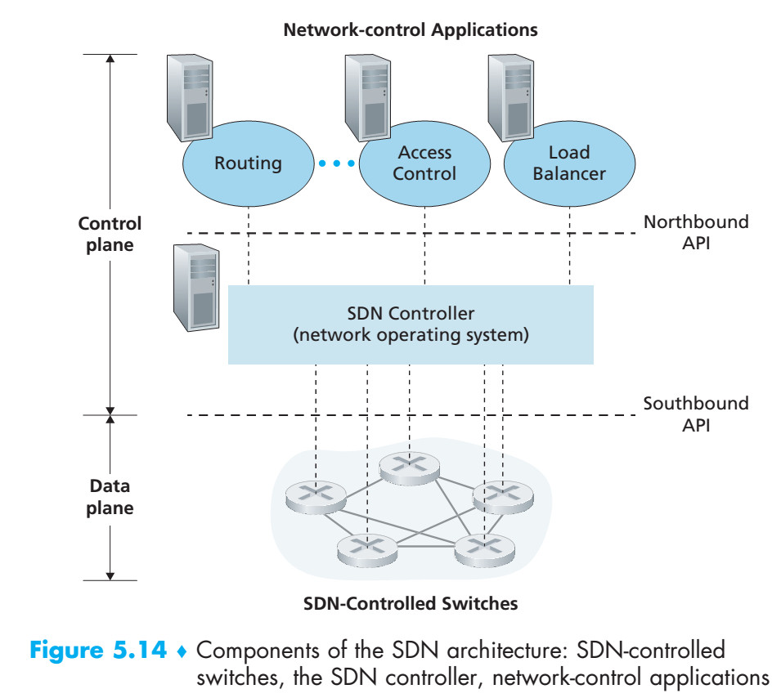

Slide 91
From this discussion, we can see that SDN represents a significant “unbundling” of network functionality == data plane switches, SDN controllers, and network-control applications are separate entities that may each be provided by different vendors and organizations.
This contrasts with the pre-SDN model in which a switch/router (together with its embedded control plane software and protocol implementations) was monolithic, vertically integrated, and sold by a single vendor.
This unbundle of network functionality in SDN has been likened to the earlier evolution from
Mainframe computers (where hardware, system software, and applications were provided by a single vendor)
Personal computers (with their separate hardware, operating systems, and applications).
The unbundling of computing hardware, system software, and applications has arguably led to a rich, open ecosystem driven by innovation in all three of these areas; one hope for SDN is that it too will lead to a such rich innovation.

Slide 92
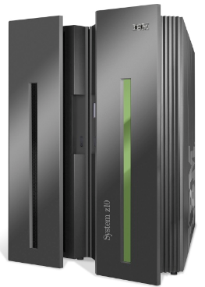

Analogy: mainframe to PC evolution*
App
App
App
App
App
App
App
App
App
App
App
Specialized
Applications
Open Interface
Specialized
Operating
System
Windows
(OS)
Linux
Mac
OS
or
or
Specialized
Hardware
Open Interface
Microprocessor
Vertically integrated
Closed, proprietary
Slow innovation
Small industry
Horizontal
Open interfaces
Rapid innovation
Huge industry
* Slide courtesy: N. McKeown

Slide 93
Given our understanding of the SDN architecture of Figure 5.14, many questions naturally arise. How and where are the flow tables actually computed?
How are these tables updated in response to events at SDN-controlled devices (e.g., an attached link going up/down)?
And how are the flow table entries at multiple switches coordinated in such a way as to result in orchestrated (plan, coordinate) and consistent network-wide functionality (e.g., end-to-end paths for forwarding packets from sources to destinations, or coordinated distributed firewalls)?
It is the role of the SDN control plane to provide these, and many other, capabilities
Notes:
plan or coordinate the elements of (a situation) to produce a desired effect,

Slide 94
5.5.2 The SDN Control Plane: SDN Controller and SDN Network-control Applications
Let’s begin our discussion of the SDN control plane in the abstract, by considering the generic capabilities that the control plane must provide. As we’ll see, this abstract, “first principles” approach will lead us to an overall architecture that reflects how SDN control planes have been implemented in practice.
SDN control plane divides broadly into two components
------→The SDN controller
------→And the SDN network-control applications.
Let’s explore the controller first. Many SDN controllers have been developed since the earliest SDN controller [Gude 2008]; see [Kreutz 2015] for an extremely thorough and up-to-date survey.
Figure 5.15 provides a more detailed view of a generic SDN controller. A controller’s functionality can be broadly organized into three layers.

Slide 95
Components of SDN controller
Figure 5.15
routing
access
control
load
balance
Interface layer to network control apps: abstractions API
Interface, abstractions for network control apps
…
network graph
RESTful
API
intent
Network-wide state management layer: state of networks links, switches, services: a distributed database
…
statistics
flow tables
SDN
controller
Network-wide distributed, robust state management
…
Link-state info
host info
switch info
…
communication layer: communicate between SDN controller and controlled switches
OpenFlow
SNMP
Communication to/from controlled devices

Slide 96
• A communication layer:
Communicating between the SDN controller and controlled network devices.
Clearly, if an SDN controller is going to control the operation of a remote SDN-enabled switch, host, or other device, a protocol is needed to transfer information between the controller and that device.
In addition, a device must be able to communicate locally-observed events to the controller (e.g., a message indicating that an attached link has gone up or down, that a device has just joined the network)
These events provide the SDN controller with an up-to-date view of the network’s state. This protocol constitutes the lowest layer of the controller architecture, as shown in Figure 5.15.
The communication between the controller and the controlled devices cross what has come to be known as the controller’s “southbound” interface.
In Section 5.5.2, we’ll study OpenFlow—a specific protocol that provides this communication functionality. OpenFlow is implemented in most, if not all, SDN controllers.

Slide 97
• A network-wide state-management layer.
The ultimate control decisions made by the SDN control plane—e.g.,
Configuring flow tables in all switches to achieve the desired end-end forwarding,
To implement load balancing,
Or to implement a particular firewalling capability—will require that the controller have up-to-date information about state of the networks’ hosts, links, switches, and other SDN controlled devices.
A switch’s flow table contains counters whose values might also be profitably used by network-control applications; these values should thus be available to the applications.
Since the ultimate aim of the control plane is to determine flow tables for the various controlled devices,
A controller might also maintain a copy of these tables.
These pieces of information all constitute examples of the network-wide “state” maintained by the SDN controller.

Slide 98
• The interface to the network-control application layer.
The controller interacts with network-control applications through its “northbound” interface.
This API allows network-control applications to read/write network state and flow tables within the state-management layer.
Applications can register to be notified when state-change events occur, so that they can take actions in response to network event notifications sent from SDN-controlled devices.
Different types of APIs may be provided; we’ll see that two popular SDN controllers communicate with their applications using a REST [Fielding 2000] request-response interface.

Slide 99
We have noted several times that an SDN controller can be considered to be “logically centralized,” i.e., that the controller may be viewed externally (e.g., from the point of view of SDN-controlled devices and external network-control applications) as a single, monolithic service.
However, these services and the databases used to hold state information are implemented in practice by a distributed set of servers for fault tolerance, high availability, or for performance reasons.
Modern controllers such as OpenDaylight [OpenDaylight Lithium 2016] and ONOS [ONOS 2016] have placed considerable emphasis on architecting a logically centralized but physically distributed controller platform that provides scalable services and high availability to the controlled devices and network-control applications alike.

Slide 100
The architecture depicted in Figure 5.15 closely resembles the architecture of the originally proposed NOX controller in 2008 [Gude 2008], as well as that of today’s OpenDaylight [OpenDaylight Lithium 2016] and ONOS [ONOS 2016]
First, however, let’s examine the OpenFlow protocol, which lies in the controller’s communication layer.

Slide 101

OpenFlow protocol
operates between controller, switch
TCP used to exchange messages
optional encryption
three classes of OpenFlow messages:
controller-to-switch
asynchronous (switch to controller)
symmetric (misc)
OpenFlow Controller

Slide 102

OpenFlow: controller-to-switch messages
Key controller-to-switch messages
features: controller queries switch features, switch replies
configure: controller queries/sets switch configuration parameters
modify-state: add, delete, modify flow entries in the OpenFlow tables
packet-out: controller can send this packet out of specific switch port
OpenFlow Controller

Slide 103
OpenFlow: switch-to-controller messages
Key switch-to-controller messages
packet-in: transfer packet (and its control) to controller. See packet-out message from controller
flow-removed: flow table entry deleted at switch
port status: inform controller of a change on a port.
OpenFlow Controller
Fortunately, network operators don’t “program” switches by creating/sending OpenFlow messages directly. Instead use higher-level abstraction at controller

Slide 104
SDN: control/data plane interaction example
Dijkstra’s link-state
Routing
1
S1, experiencing link failure using OpenFlow port status message to notify controller
4
5
…
network graph
RESTful
API
intent
2
SDN controller receives OpenFlow message, updates link status info
3
…
statistics
flow tables
…
3
Dijkstra’s routing algorithm application has previously registered to be called when ever link status changes. It is called.
Link-state info
host info
switch info
2
…
OpenFlow
SNMP
6
4
Dijkstra’s routing algorithm access network graph info, link state info in controller, computes new routes
1
s2
s1
s4
s3

Slide 105
SDN: control/data plane interaction example
Dijkstra’s link-state
Routing
4
5
…
network graph
RESTful
API
intent
5
link state routing app interacts with flow-table-computation component in SDN controller, which computes new flow tables needed
3
…
statistics
flow tables
…
Link-state info
host info
switch info
2
…
6
Controller uses OpenFlow to install new tables in switches that need updating
OpenFlow
SNMP
6
1
s2
s1
s4
s3

Slide 106
OpenDaylight (ODL) controller
…
Traffic
Engineering
ODL Lithium controller
network apps may be contained within, or be external to SDN controller
Service Abstraction Layer: interconnects internal, external applications and services
REST API
Network service apps
Basic Network Service Functions
topology
manager
switch
manager
stats
manager
Access
Control
forwarding
manager
host
manager
Service Abstraction Layer (SAL)
…
OpenFlow 1.0
SNMP
OVSDB

Slide 107
ONOS controller
…
Network
control apps
control apps separate from controller
intent framework: high-level specification of service: what rather than how
considerable emphasis on distributed core: service reliability, replication performance scaling
northbound abstractions,
protocols
REST API
Intent
hosts
paths
flow rules
topology
ONOS
distributed core
devices
links
statistics
device
link
host
flow
packet
southbound abstractions,
protocols
OpenFlow
Netconf
OVSDB

Slide 108
SDN: selected challenges
hardening the control plane: dependable, reliable, performance-scalable, secure distributed system
robustness to failures: leverage strong theory of reliable distributed system for control plane
dependability, security: “baked in” from day one?
networks, protocols meeting mission-specific requirements
e.g., real-time, ultra-reliable, ultra-secure
Internet-scaling

Slide 109
Chapter 5: outline
5.1 introduction
5.2 routing protocols
link state
distance vector
5.3 intra-AS routing in the Internet: OSPF
5.4 routing among the ISPs: BGP
5.5 The SDN control plane
5.6 ICMP: The Internet Control Message Protocol
5.7 Network management and SNMP

Slide 110
ICMP
The IP protocol has no error-reporting or error-correcting mechanism. The IP protocol also lacks a mechanism for host and management queries. The Internet Control Message Protocol (ICMP) has been designed to compensate for the above two deficiencies. It is a companion to the IP protocol.
Topics discussed in this section:
Types of Messages Message Format Error Reporting and Query
Debugging Tools

Slide 111
The IP protocol is a best-effort delivery service that delivers a datagram from its original source to its final destination.
However, it has two deficiencies:
lack of error control and
lack of assistance mechanisms.
OR
The IP protocol has no error-reporting or error-correcting mechanism.
So from above issues some questions arrises:
What happens if something goes wrong?
What happens if a router must discard a datagram because it cannot find a router to the final destination, or because the time-to-live field has a zero value?
What happens if the final destination host must discard all fragments of a datagram because it has not received all fragments within a predetermined time limit?

Slide 112
These are examples of situations where an error has occurred and the IP protocol has no built-in mechanism to notify the original host.
The IP protocol also lacks a mechanism for host and management queries. A host sometimes needs to determine if a router or another host is alive.
And sometimes a network administrator needs information from another host or router.
The Internet Control Message Protocol (ICMP) has been designed to compensate for the above two deficiencies. It is a companion to the IP protocol

Slide 113
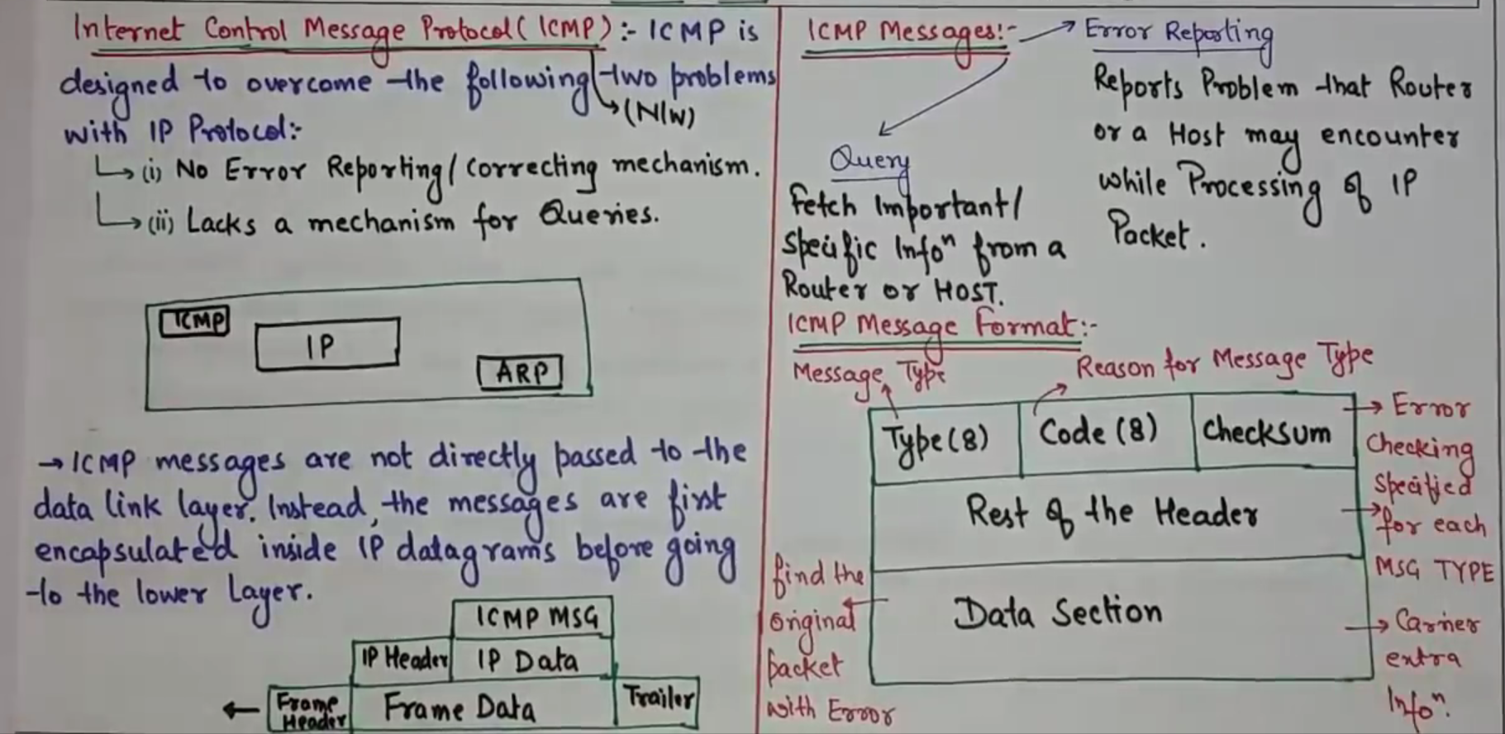

Slide 114
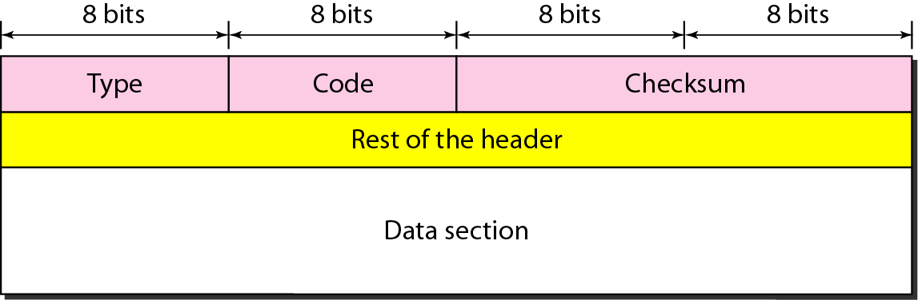
Figure 21.8 General format of ICMP messages

Slide 115
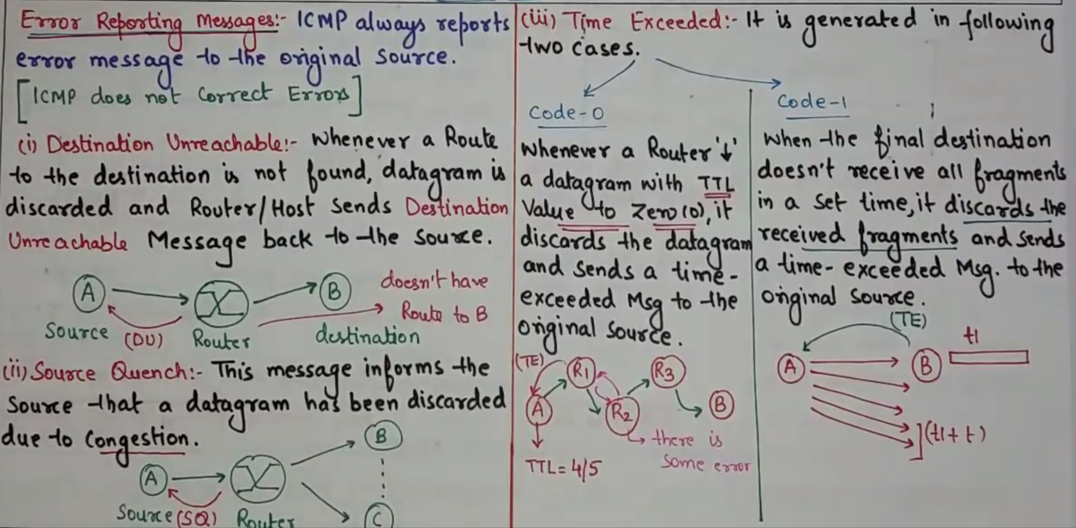

Slide 116

Note
ICMP always reports error messages to the original source.

Slide 117
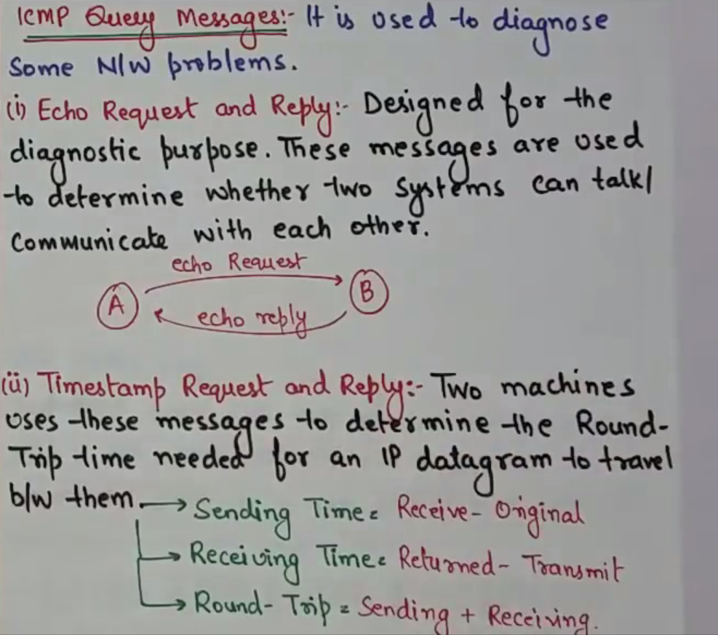

Slide 118
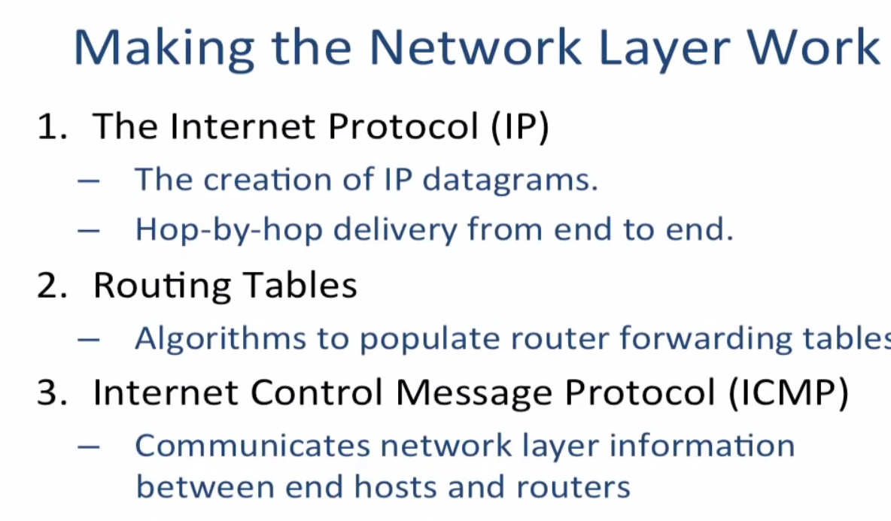

Slide 119
ICMP: internet control message protocol
used by hosts & routers to communicate network-level information
error reporting: unreachable host, network, port, protocol
echo request/reply (used by ping)
network-layer “above” IP:
ICMP msgs carried in IP datagrams
ICMP message: type, code plus first 8 bytes of IP datagram causing error
Type Code description
0 0 echo reply (ping)
3 0 dest. network unreachable
3 1 dest host unreachable
3 2 dest protocol unreachable
3 3 dest port unreachable
3 6 dest network unknown
3 7 dest host unknown
4 0 source quench (congestion
control - not used)
8 0 echo request (ping)
9 0 route advertisement
10 0 router discovery
11 0 TTL expired
12 0 bad IP header

Slide 120
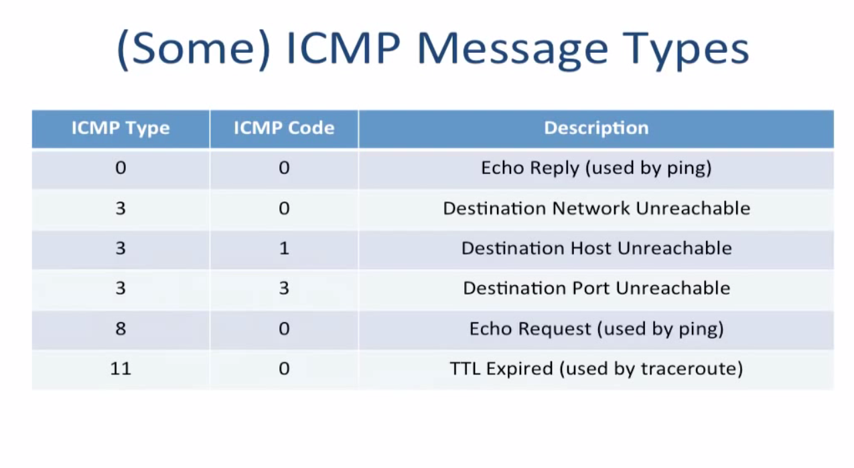

Slide 121
In Chapter 1 we introduced the Traceroute program, which allows us to trace a route from a host to any other host in the world.
Interestingly, Traceroute is implemented with ICMP messages.
To determine the names and addresses of the routers between source and destination, Traceroute in the source sends a series of ordinary IP datagrams to the destination.
Each of these datagrams carries a UDP segment with an unlikely UDP port number. The first of these datagrams has a TTL of 1, the second of 2, the third of 3, and so on.
The source also starts timers for each of the datagrams.
When the nth datagram arrives at the nth router, the nth router observes that the TTL of the datagram has just expired. According to the rules of the IP protocol, the router discards the datagram and sends an ICMP warning message to the source (type 11 code 0).
This warning message includes the name of the router and its IP address.
When this ICMP message arrives back at the source, the source obtains the round-trip time from the timer and the name and IP address of the nth router from the ICMP message.

Slide 122
How does a Traceroute source know when to stop sending UDP segments?
Recall that the source increments the TTL field for each datagram it sends.
Thus, one of the datagrams will eventually make it all the way to the destination host.
Because this datagram contains a UDP segment with an unlikely port number, the destination host sends a port unreachable ICMP message (type 3 code 3) back to the source.
When the source host receives this particular ICMP message, it knows it does not need to send additional probe packets. (The standard Traceroute program actually sends sets of three packets with the same TTL; thus the Traceroute output provides three results for each TTL.)
In this manner, the source host learns the number and the identities of routers that lie between it and the destination host and the round-trip time between the two hosts.
Note that the Traceroute client program must be able to instruct the operating system to generate UDP datagrams with specific TTL values and must also be able to be notified by its operating system when ICMP messages arrive.

Slide 123


Traceroute and ICMP
source sends series of UDP segments to destination
first set has TTL =1
second set has TTL=2, etc.
unlikely port number
when datagram in nth set arrives to nth router:
router discards datagram and sends source ICMP message (type 11, code 0)
ICMP message include name of router & IP address
when ICMP message arrives, source records RTTs
stopping criteria:
UDP segment eventually arrives at destination host
destination returns ICMP “port unreachable” message (type 3, code 3)
source stops
3 probes
3 probes
3 probes

Slide 124
Very imp link to understand traceroute app working
https://www.xfinity.com/support/articles/run-traceroute-command

Slide 125
Chapter 5: outline
5.1 introduction
5.2 routing protocols
link state
distance vector
5.3 intra-AS routing in the Internet: OSPF
5.4 routing among the ISPs: BGP
5.5 The SDN control plane
5.6 ICMP: The Internet Control Message Protocol
5.7 Network management and SNMP

Slide 126
What is network management?
autonomous systems (aka “network”): 1000s of interacting hardware/software components
other complex systems requiring monitoring, control:
jet airplane
nuclear power plant
others?
"Network management includes the deployment, integration
and coordination of the hardware, software, and human
elements to monitor, test, poll, configure, analyze, evaluate,
and control the network and element resources to meet the
real-time, operational performance, and Quality of Service
requirements at a reasonable cost."

Slide 127
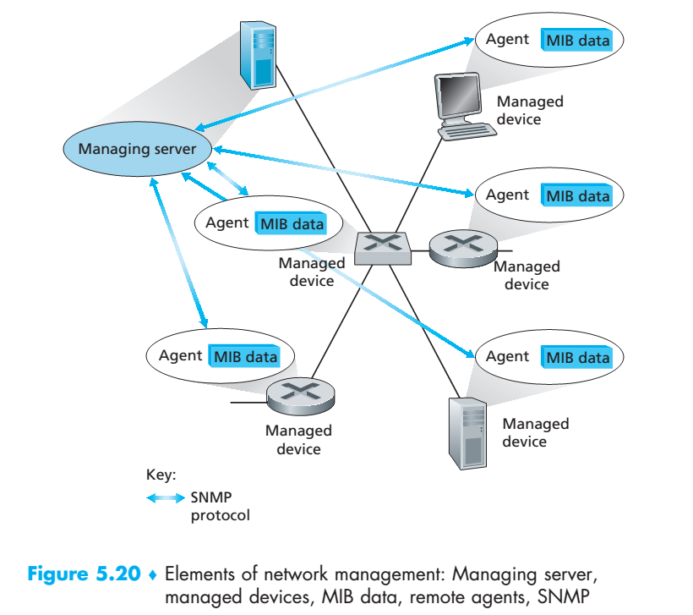

Slide 128
5.7.1 The Network Management Framework
Figure 5.20 shows the key components of network management:
• The managing server is an application, typically with a human in the loop, running in a centralized network management station in the network operations center (NOC).
The managing server is the locus of activity for network management; it controls the collection, processing, analysis, and/or display of network management information.
It is here that actions are initiated to control network behavior and here that the human network administrator interacts with the network’s devices.

Slide 129
A managed device: is a piece of network equipment (including its software) that resides on a managed network.
A managed device might be a host, router, switch, middlebox, modem, thermometer, or other network-connected device.
There may be several so-called managed objects within a managed device.
These managed objects are the actual pieces of hardware within the managed device (for example, a network interface card is but one component of a host or router), and configuration parameters for these hardware and software components (for example, an intra-AS routing protocol such as OSPF).

Slide 130
Management Information Base (MIB):
Each managed object within a managed device associated information that is collected into a Management Information Base (MIB);
The values of these pieces of information are available to (and in many cases able to be set by) the managing server.
A MIB object might be a counter, such as
The number of IP datagrams discarded at a router due to errors in an IP datagram header.
or the number of UDP segments received at a host;
Descriptive information such as the version of the software running on a DNS server
Status information such as whether a particular device is functioning correctly;
or protocol-specific information such as a routing path to a destination..

Slide 131
Network management agent : Also resident in each managed device is a network management agent, a process running in the managed device that communicates with the managing server, taking local actions at the managed device under the command and control of the managing server. The network management agent is similar to the routing agent that we saw in Figure 5.2.
Network management protocol
The protocol runs between the managing server and the managed devices
Allowing the managing server to query the status of managed devices and indirectly take actions at these devices via its agents.
Agents can use the network management protocol to inform the managing server of exceptional events (for example, component failures or violation of performance thresholds).
It’s important to note that the network management protocol does not itself manage the network.
Instead, it provides capabilities that a network administrator can use to manage (“monitor, test, poll, configure, analyze, evaluate, and control”) the network.

Slide 132


Infrastructure for network management
definitions:
managing entity
agent
data
managing
entity
managed devices contain managed objects whose data is gathered into a Management Information Base (MIB)
data
managed device
network
management
protocol
agent
data
managed device
agent
data
managed device
agent
data
agent
data
managed device
managed device

Slide 133
5.7.2 The Simple Network Management Protocol (SNMP)
The Simple Network Management Protocol version 2 (SNMPv2) [RFC 3416] is an application-layer protocol
Used to convey network-management control and information messages between a managing server and an agent executing on behalf of that managing server.
The most common usage of SNMP is in a request-response mode in which an SNMP managing server sends a request to an SNMP agent, who receives the request, performs some action, and sends a reply to the request.
Typically, a request will be used to query (retrieve) or modify (set) MIB object values associated with a managed device.
A second common usage of SNMP is for an agent to send an unsolicited message, known as a trap message, to a managing server.
Trap messages are used to notify a managing server of an exceptional situation (e.g., a link interface going up or down) that has resulted in changes to MIB object values.
SNMPv2 defines seven types of messages, known generically as protocol data units—PDUs

Slide 134


SNMP protocol
Two ways to convey MIB info, commands:
managing
entity
managing
entity
request
trap msg
response
agent
data
agent
data
managed device
managed device
request/response mode
trap mode

Slide 135
SNMP protocol: message types
Message type
Function
GetRequest
GetNextRequest
GetBulkRequest
manager-to-agent: “get me data”
(data instance, next data in list, block of data)
InformRequest
manager-to-manager: here’s MIB value
SetRequest
manager-to-agent: set MIB value
Response
Agent-to-manager: value, response to
Request
Trap
Agent-to-manager: inform manager
of exceptional event

Slide 136
The GetRequest, GetNextRequest, and GetBulkRequest PDUs are all sent from a managing server to an agent to request the value of one or more MIB objects at the agent’s managed device.
The MIB objects whose values are being requested are specified in the variable binding portion of the PDU.
GetRequest, GetNextRequest, and GetBulkRequest differ in the granularity of their data requests.
1. GetRequest can request an arbitrary set of MIB values
2. Multiple GetNextRequests can be used to sequence through a list or table of MIB objects;
3. GetBulkRequest allows a large block of data to be returned, avoiding the overhead incurred if multiple GetRequest orGetNextRequest messages were to be sent. In all three cases, the agent responds with a Response PDU containing the object identifiers and their associated values.

Slide 137
4. The SetRequest PDU is used by a managing server to set the value of one or more MIB objects in a managed device.
An agent replies with a Response PDU with the “noError” error status to confirm that the value has indeed been set.
5. The InformRequest PDU is used by a managing server to notify another managing server of MIB information that is remote to the receiving server.
6. The Response PDU is typically sent from a managed device to the managing server in response to a request message from that server, returning the requested information.
7. The final type of SNMPv2 PDU is the trap message.
Trap messages are generated asynchronously; that is, they are not generated in response to a received request but rather in response to an event for which the managing server requires notification.

Slide 138
Given the request-response nature of SNMP, it is worth noting here that although SNMP PDUs can be carried via many different transport protocols,
the SNMP PDU is typically carried in the payload of a UDP datagram that UDP is “the preferred transport mapping.”
However, since UDP is an unreliable transport protocol, there is no guarantee that a request, or its response, will be received at the intended destination.

Slide 139
SNMP protocol: message formats
Get/set header
Variables to get/set
PDU
type
(0-3)
Error
Status
(0-5)
Request
ID
Error
Index
Name
Value
Name
Value
….
PDU
type
4
Trap
Type
(0-7)
Enterprise
Agent
Addr
Specific
code
Time
stamp
Name
Value
….
Trap header
Trap info
SNMP PDU
More on network management: see earlier editions of text!

Slide 140
The request ID field of the PDU is used by the managing server to number its requests to an agent; the agent’s response takes its request ID from that of the received request.
Thus, the request ID field can be used by the managing server to detect lost requests or replies.
It is up to the managing server to decide whether to retransmit a request if no corresponding response is received after a given amount of time.
In particular, the SNMP standard does not mandate any particular procedure for retransmission, or even if retransmission is to be done in the first place.
It only requires that the managing server “needs to act responsibly in respect to the frequency and duration of retransmissions.”
SNMP has evolved through three versions. The designers of SNMPv3 have said that “SNMPv3 can be thought of as SNMPv2 with additional security and administration capabilities

Slide 141
Chapter 5: summary
we’ve learned a lot!
approaches to network control plane
per-router control (traditional)
logically centralized control (software defined networking)
traditional routing algorithms
implementation in Internet: OSPF, BGP
SDN controllers
implementation in practice: ODL, ONOS
Internet Control Message Protocol
network management
next stop: link layer!

